Slide 1

Wireless Networking
Ambuj Varshney
ambujv@nus.edu.sg
Notes:
++ Thank you for inviting me to give this talk
++ In this talk, I will present a pathway that can enable us to make wireless embedded systems ubiquitous. I will describe my previous research efforts that tackle the critical challenges that limit the growth of wireless embedded systems. These are related to the growing energy asymmetry that exists between sensing, computation and communication blocks on these platforms.
++ Finally, I will conclude my talk by covering the research agenda that I would like to work on as a faculty member.

Slide 2
Administration and Course Logistics
Notes:
++ Over the past few years, I have designed several backscatter and beyond backscatter systems that precisely overcome these critical challenges that have limited the widespread deployment of backscatter on IoT devices.
++ The research vision that I have pursued and would like to pursue as a faculty member is to enable a massive deployment of IoT devices by bridging the energy asymmetry between sensing, computation and communication blocks by designing novel platforms and communication mechanisms. I am going to describe some of my research contributions next.

Slide 3
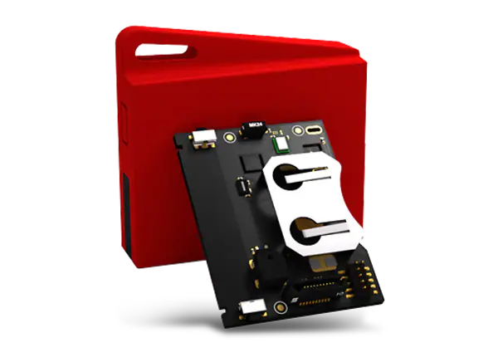
We have additional sensor tags for you ☺
We have additional sensor tags. Do you have more than two group members? Do you need additional sensor tag? Please email me.
Notes:
++ We may all have heard of the term Internet of Things. So how are these wireless embedded systems related to the Internet of Things: Today, IoT includes a broad class of devices, including powerful platforms such as smartphones. However, it also includes more resource-constrained devices and what we call Wireless Embedded Systems, and in fact, I consider it to be one of the essential parts of the IoT ecosystem.
++ These are platforms equipped with a radio transceiver, sensor, microcontroller, and some form of energy storage. These platforms also often form a network, and sensor network as it is called has been an active area of research for the past two decades.
++ The research community has also developed wireless embedded platforms which we may know about, and these include: CMUCAM, which is an image sensor platform developed at Carnegie Mellon University, or Permamote is long life sensor platform from the lab I am associated with at UC Berkeley or Lorea which is a long-range backscatter platform that I had developed as part of my doctoral dissertation at Uppsala University. All of these are an example of Wireless Embedded Systems.

Slide 4
Discussion regarding Assignment 1
Assignment 1: Some groups have already demonstrated! Kudos!
Deadline: Tutorial session 4 and 5 (after recess week).
Assignment 1: Print the name of group members
Any group member can demonstrate during the tutorial session
Notes:
++ We may all have heard of the term Internet of Things. So how are these wireless embedded systems related to the Internet of Things: Today, IoT includes a broad class of devices, including powerful platforms such as smartphones. However, it also includes more resource-constrained devices and what we call Wireless Embedded Systems, and in fact, I consider it to be one of the essential parts of the IoT ecosystem.
++ These are platforms equipped with a radio transceiver, sensor, microcontroller, and some form of energy storage. These platforms also often form a network, and sensor network as it is called has been an active area of research for the past two decades.
++ The research community has also developed wireless embedded platforms which we may know about, and these include: CMUCAM, which is an image sensor platform developed at Carnegie Mellon University, or Permamote is long life sensor platform from the lab I am associated with at UC Berkeley or Lorea which is a long-range backscatter platform that I had developed as part of my doctoral dissertation at Uppsala University. All of these are an example of Wireless Embedded Systems.

Slide 5
Discussion regarding Assignment 2
Assignment 2: Deadline 18th March
After deadline: Penalty of 10% Per Day
Please submit a readme file, source code, statement of work and a video demonstrating the operation of the sensor tag. They need to be submitted onto the canvas portal. The statement of work should describe the contribution made by every member of the group to the assignment. You need to submit the source code for Task 2 and Task 3 as separate files. Only one member of the group should submit the assignment on the canvas.
Notes:
++ We may all have heard of the term Internet of Things. So how are these wireless embedded systems related to the Internet of Things: Today, IoT includes a broad class of devices, including powerful platforms such as smartphones. However, it also includes more resource-constrained devices and what we call Wireless Embedded Systems, and in fact, I consider it to be one of the essential parts of the IoT ecosystem.
++ These are platforms equipped with a radio transceiver, sensor, microcontroller, and some form of energy storage. These platforms also often form a network, and sensor network as it is called has been an active area of research for the past two decades.
++ The research community has also developed wireless embedded platforms which we may know about, and these include: CMUCAM, which is an image sensor platform developed at Carnegie Mellon University, or Permamote is long life sensor platform from the lab I am associated with at UC Berkeley or Lorea which is a long-range backscatter platform that I had developed as part of my doctoral dissertation at Uppsala University. All of these are an example of Wireless Embedded Systems.

Slide 6
Roadmap of the lecture today
Let us recall what was covered in the last lecture
Wireless communication basics
Battery lifespan estimation
Various states of radio transceivers
Energy harvesting, low-power communication (Overview)
Notes:
Here is the roadmap of the major topics that I am going to cover during the presentation. We have already covered the exponential growth of the internet of things; next, I will talk about the critical energy challenge that can severely hinder this massive growth and preventing us from realising this immense economic value enabled by the IoT.

Slide 7
Let us review the last lecture

Slide 8
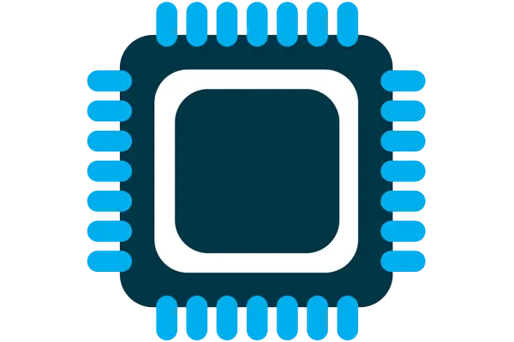
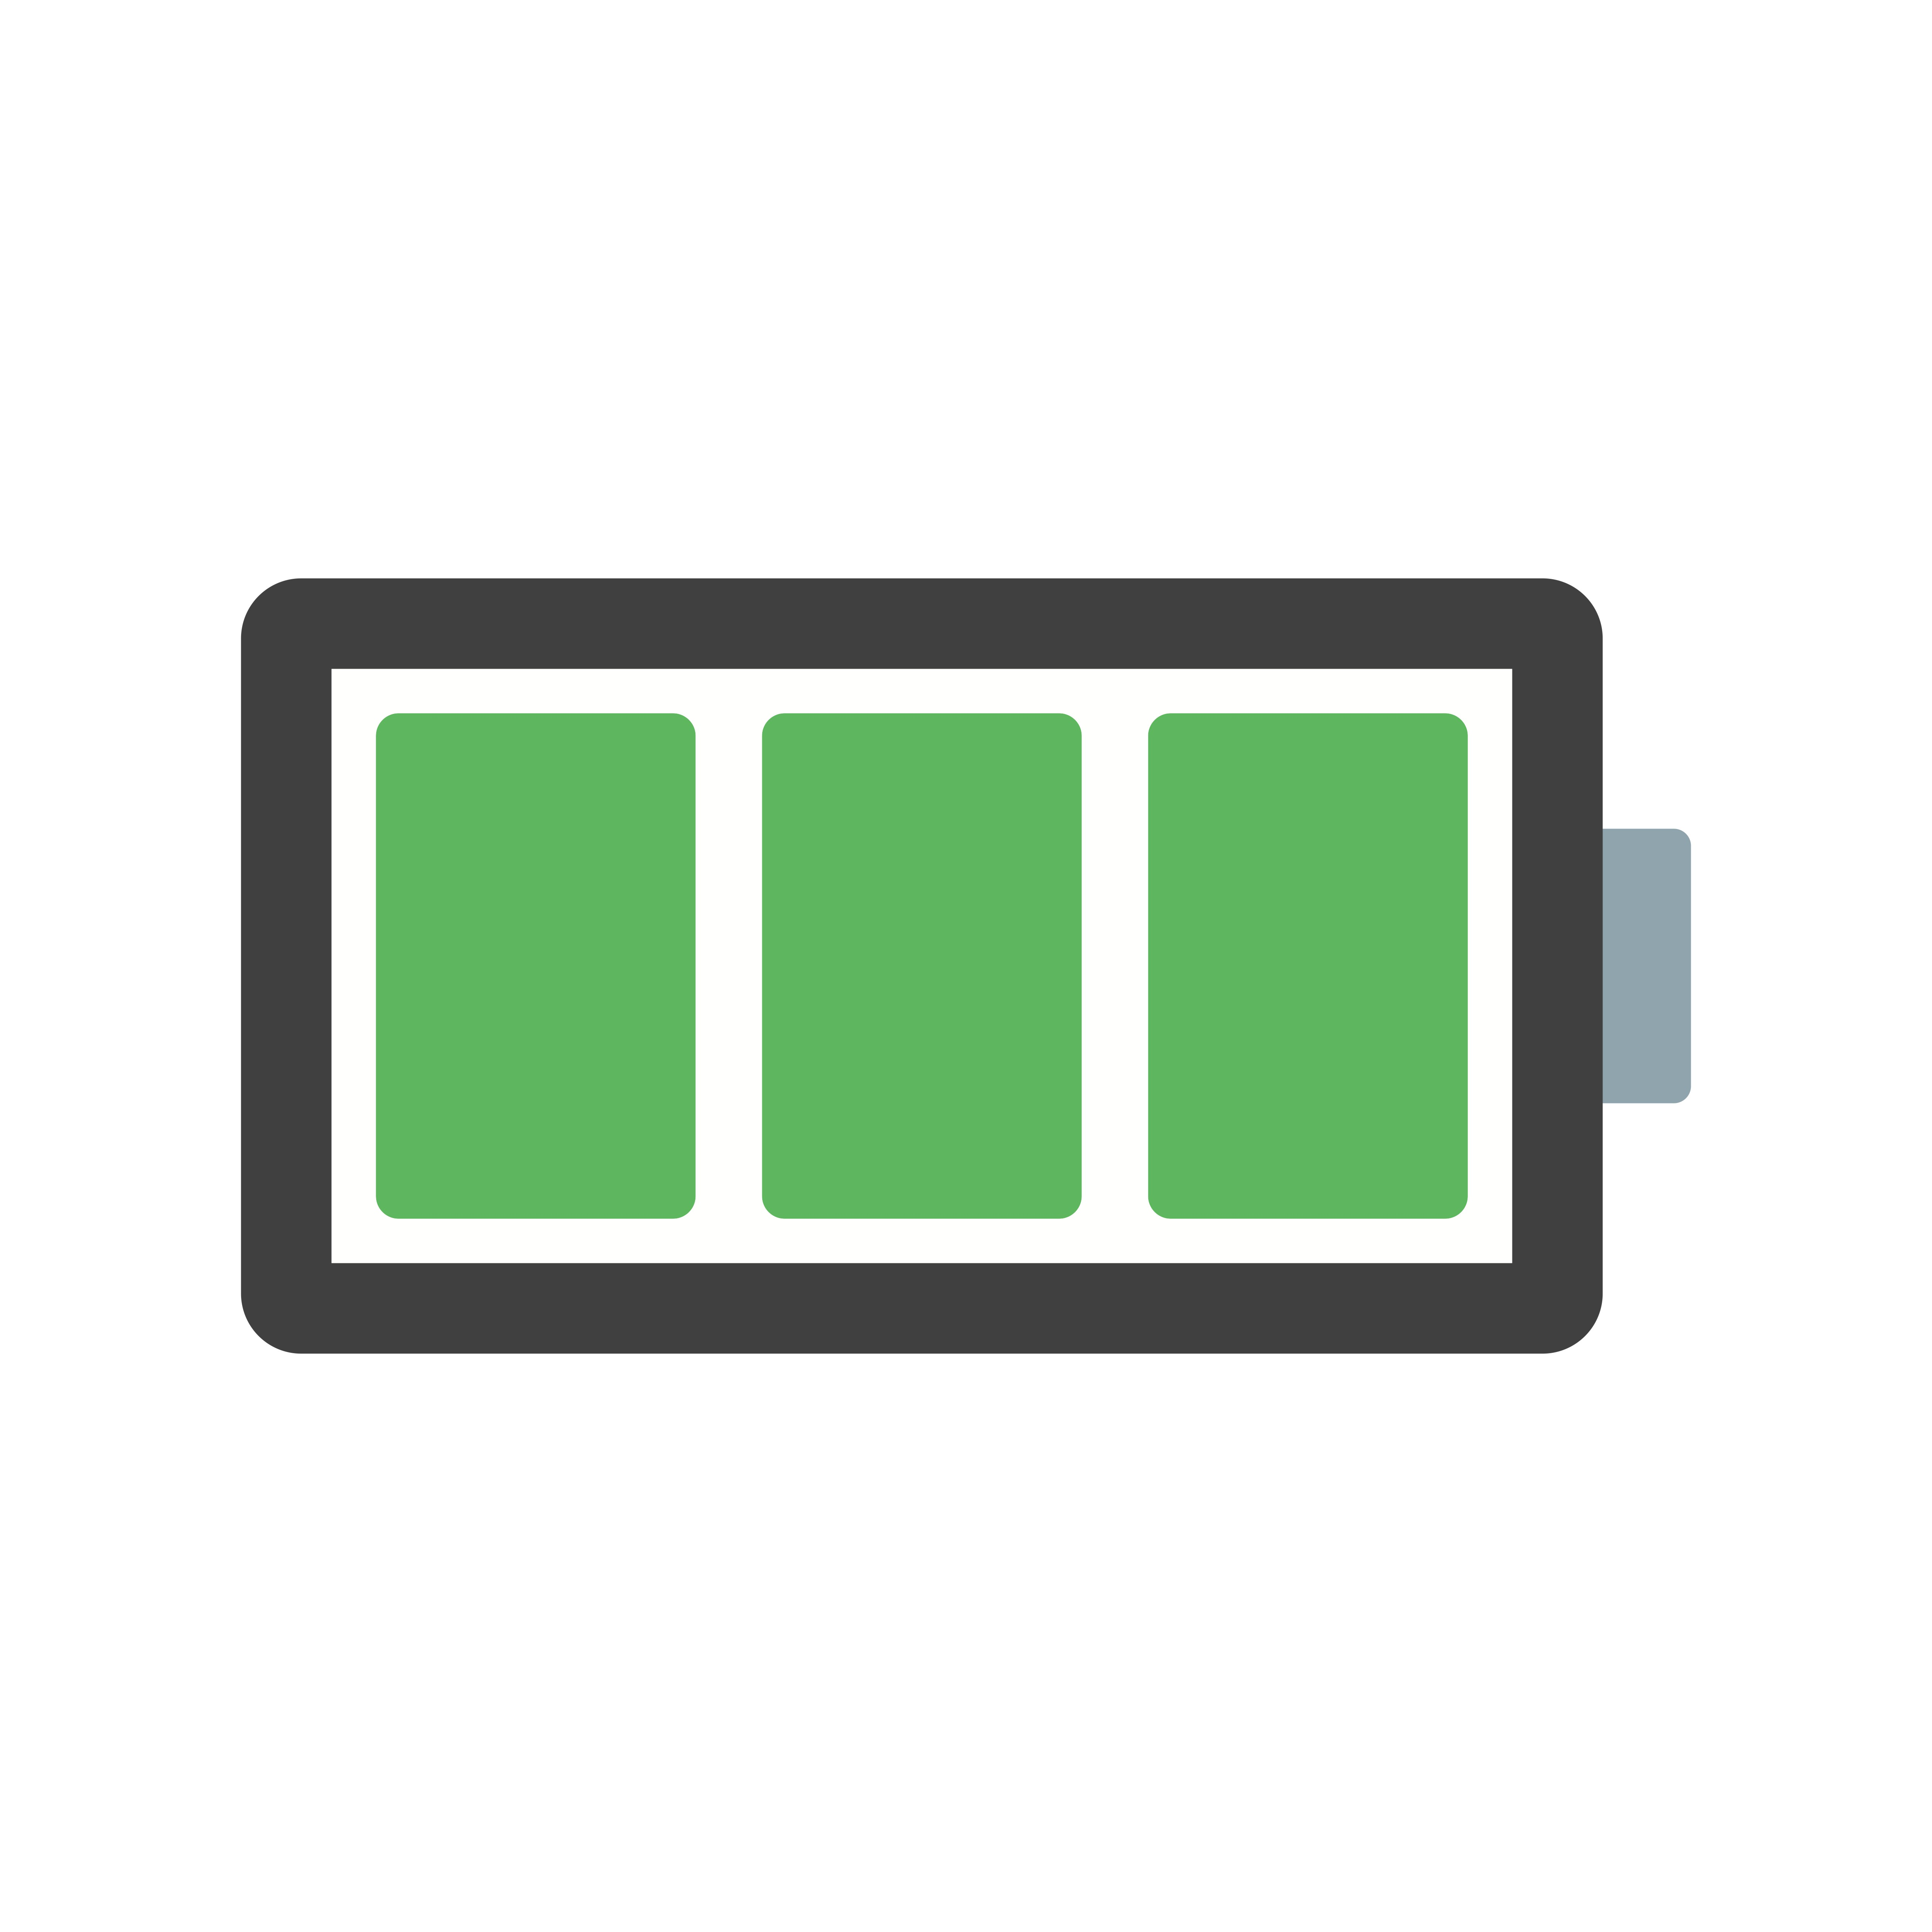


What are components of internet of things
Computation and Storage
Sensing and Actuation
Power
Wireless Connectivity
Notes:
First, we look at the computational elements, and these consist of a microcontroller or an FPGA. Today, we find that these computational elements consume at least one order of magnitude higher power consumption when compared to the commonly used sensors.
However, we also find that microcontrollers are increasingly becoming energy efficient. We investigate a typical microcontroller that has been used in sensor platforms over the past two decades. We find that energy efficiency has improved by almost two orders of magnitude. Some of the present-generation microcontrollers, such as Ambiq Apollo4 consume just 3 uA/MHz than 330 uA for MSP430 used on platforms such as TelOS B.
If the trend continues, we can expect the microcontrollers to catch up with the sensors and become energy-efficient. This significant improvement is that the digital components are increasing becoming efficient as they follow moore’s law.

Slide 9
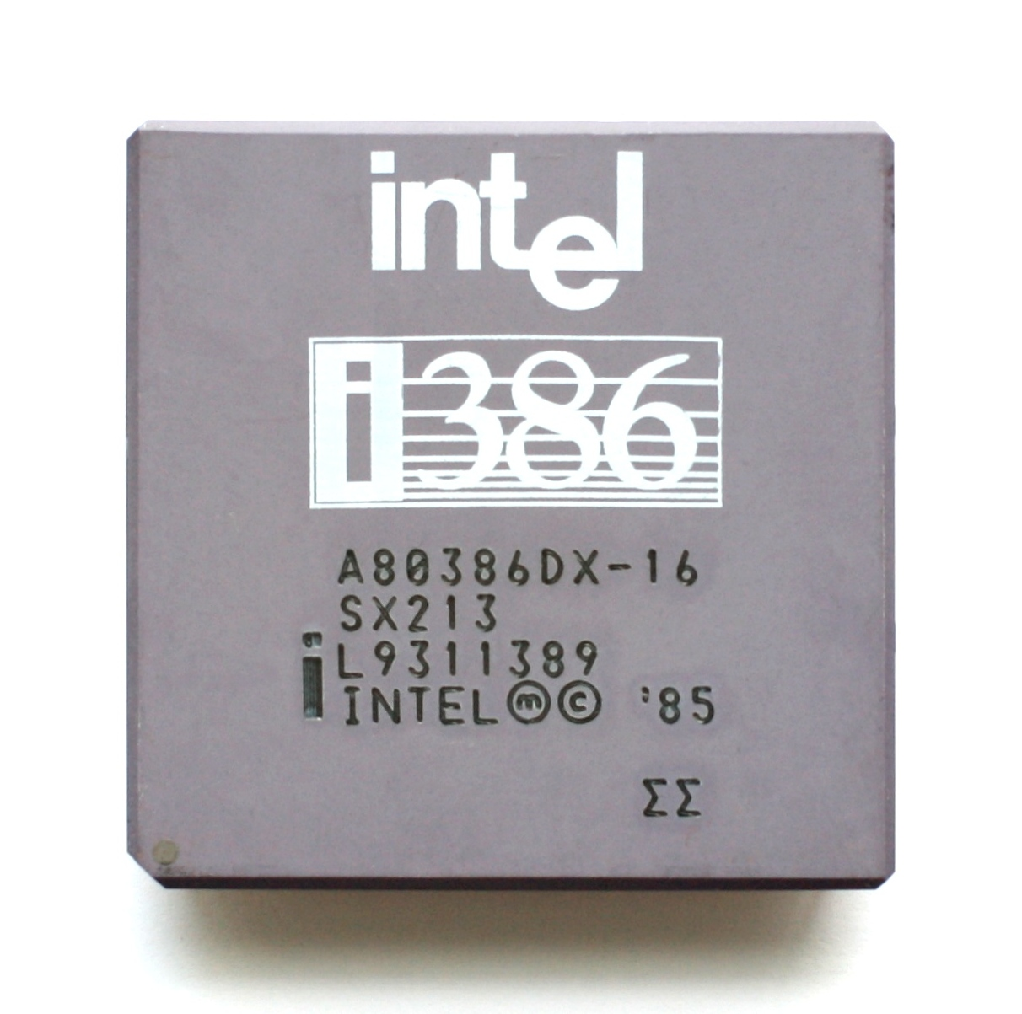
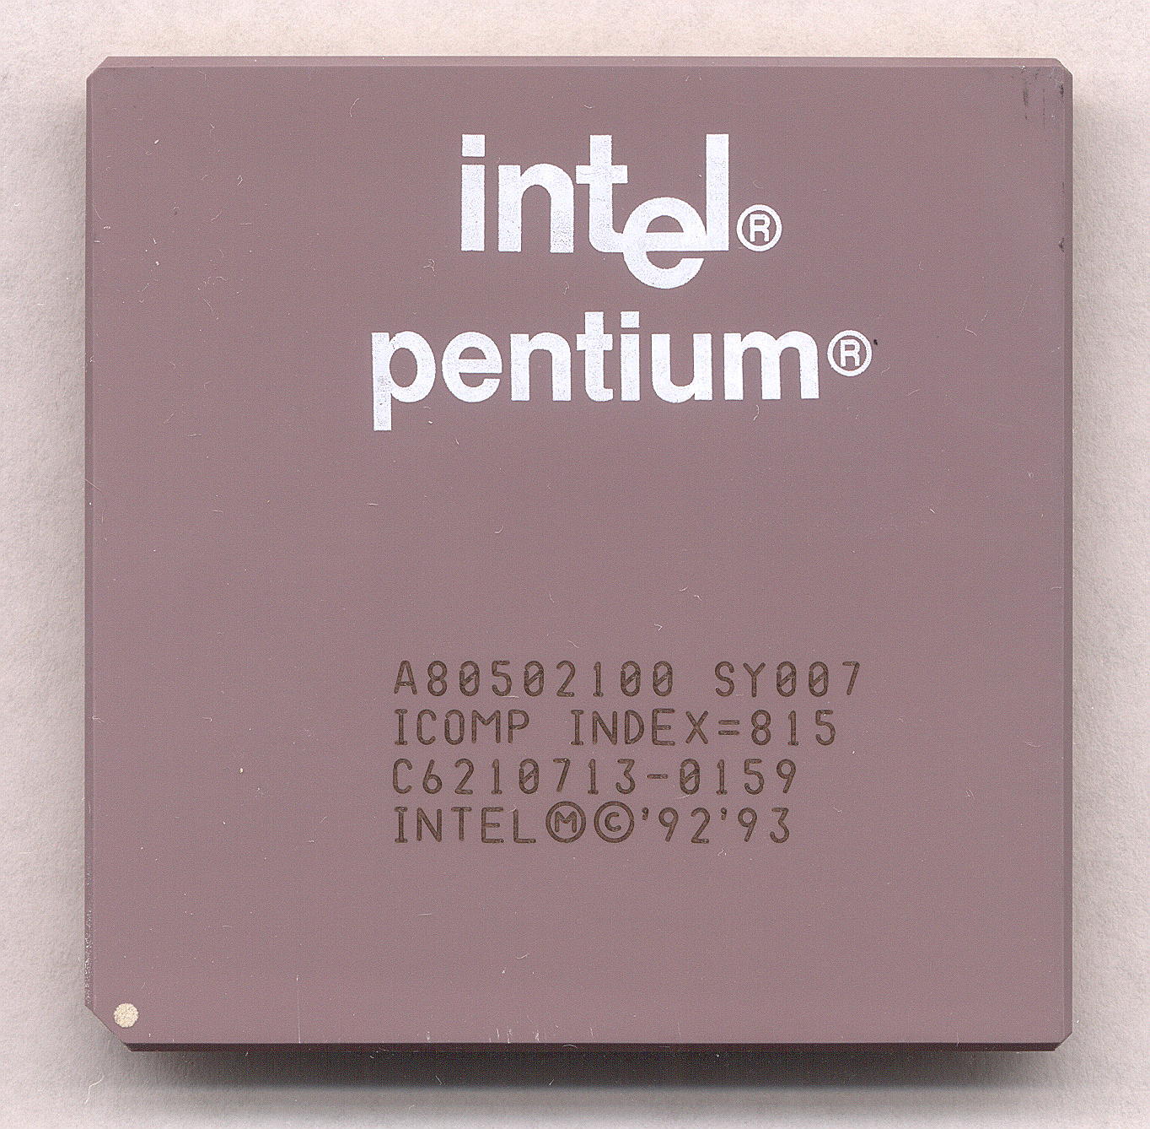
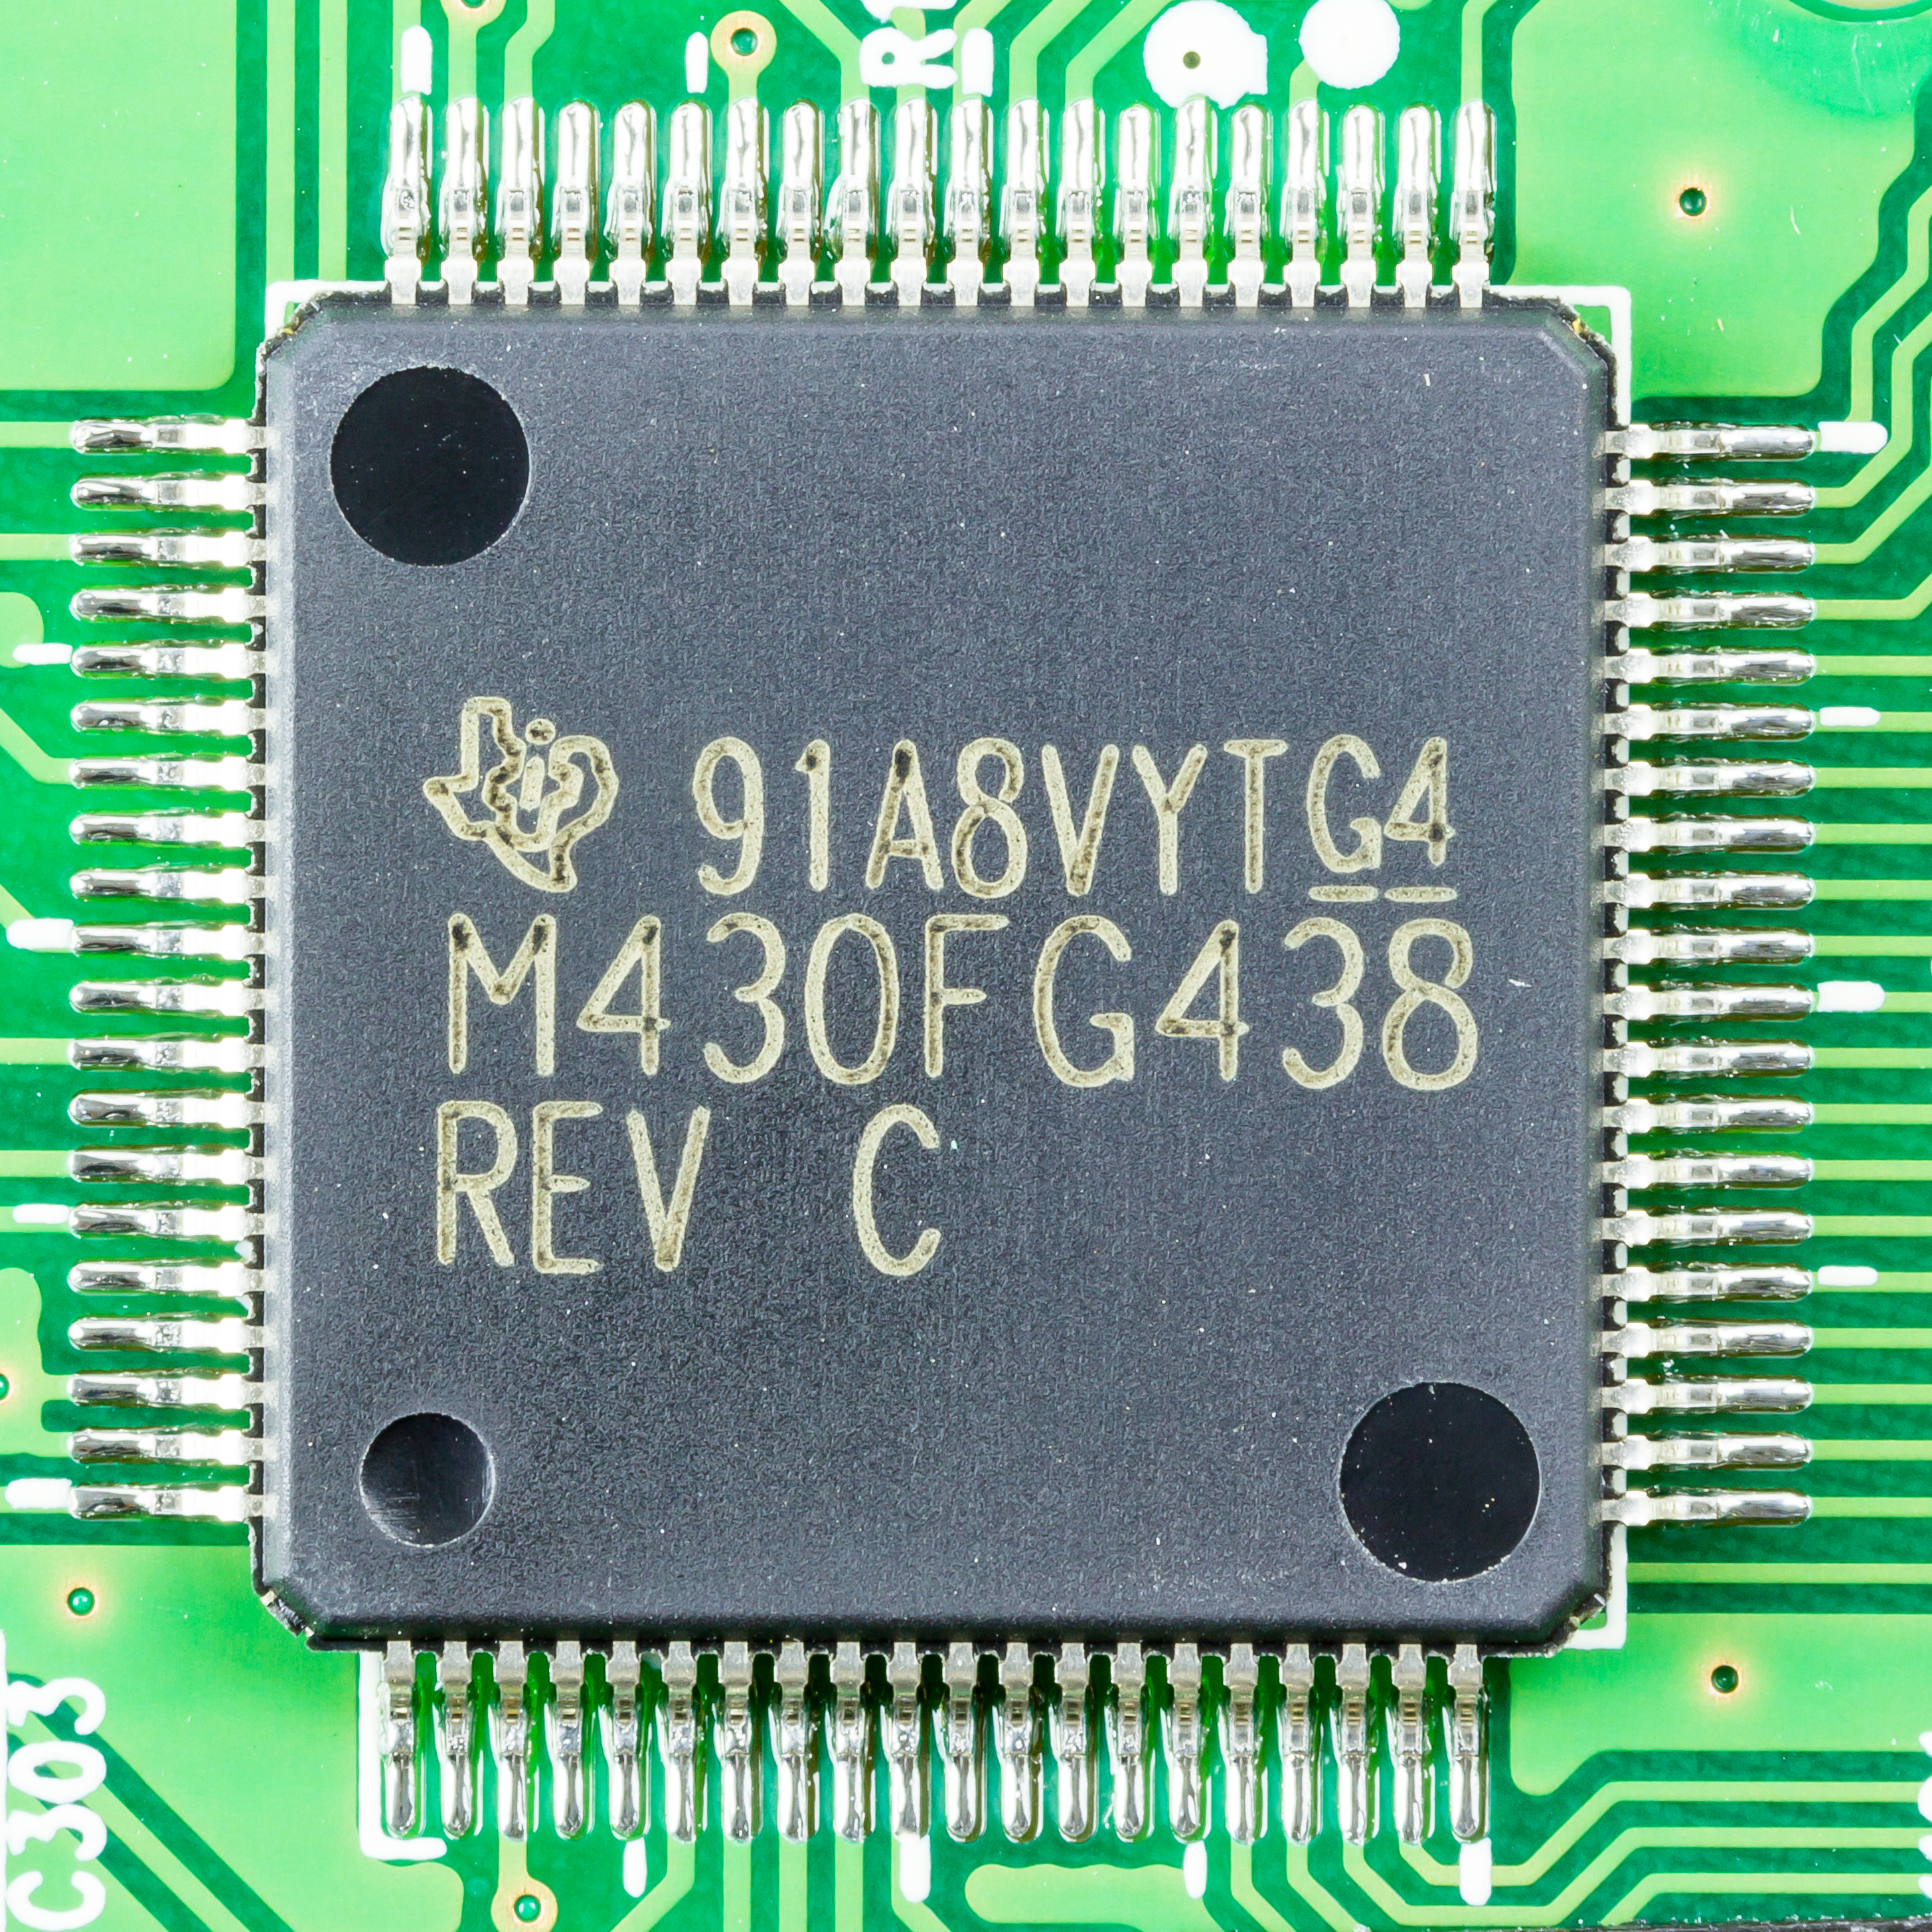
What is heart of computers and internet of things
Microprocessor (Computers)
They usually don’t have peripherals or memory
CPU + Pins (No memory, peripherals)
Your computer typically has a microprocessor
Microcontrollers (Internet of Things)
Memory + Peripherals + CPU + Pins
Peripherals: Specialized hardware units within the chip
Notes:
Backscatter communication actually help us overcome this limitation

Slide 10
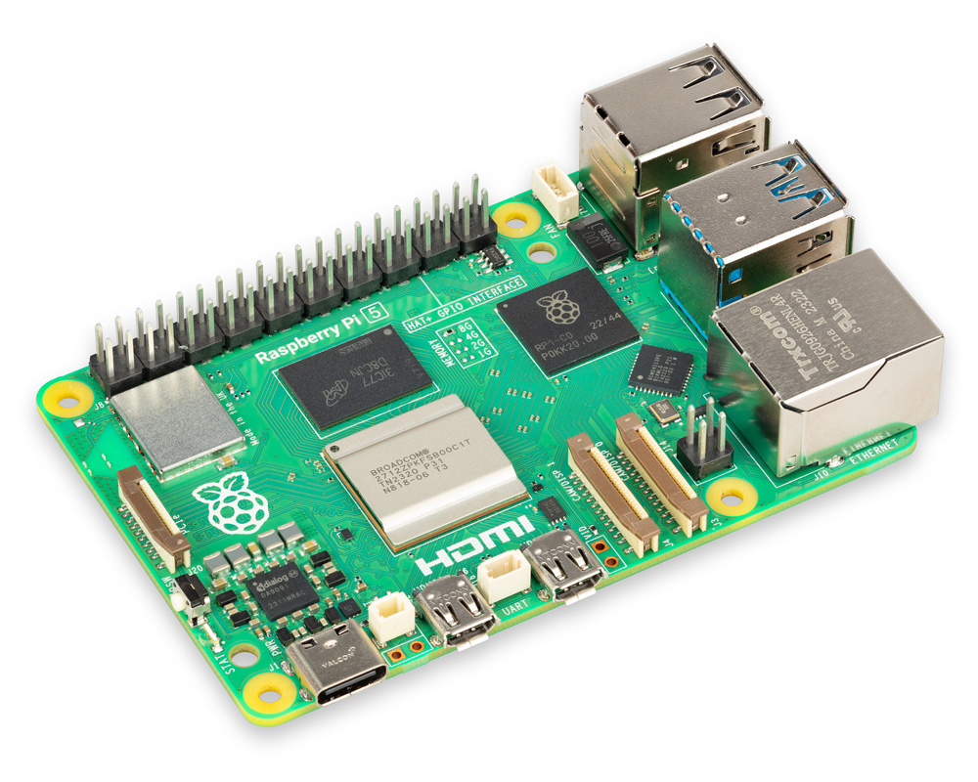
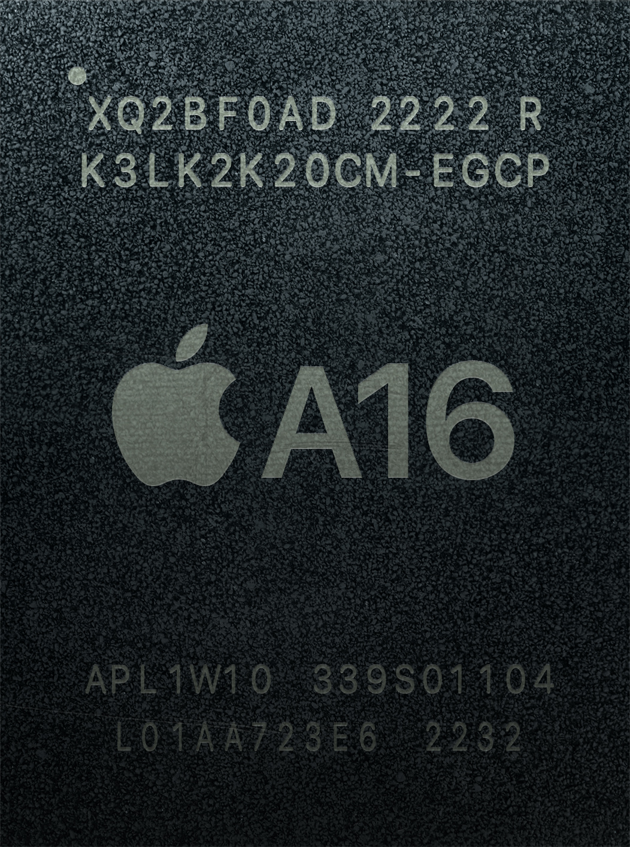
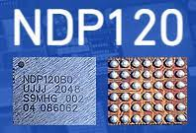
What is heart of computers and internet of things
System on chips (SoC)
Microcontroller + Extensive Peripherals
Essentially multiple chips combined
Example: Radios, ML accelerators in a single chip
Dedicated accelerator chips
Designed for a specific purpose like for speech detection
Notes:
Backscatter communication actually help us overcome this limitation

Slide 11
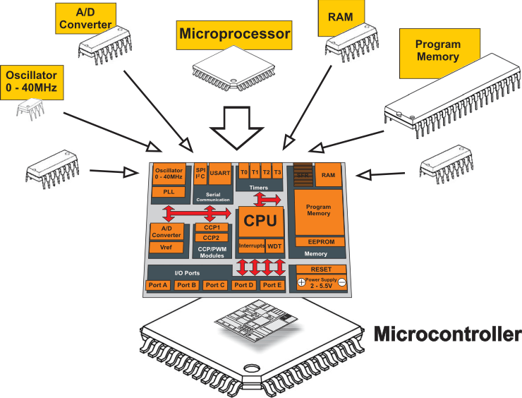
What is a microcontroller? Microprocessor + Peripherals + Memory + Pins + ?
Microcontroller
Processor
Peripherals
Pins
Memory
Notes:
Backscatter communication actually help us overcome this limitation

Slide 12
Memory on microcontroller (hierarchy)
Registers
RAM
ROM

Slide 13
SRAM (RAM) versus Flash (ROM)
Size and time difference between non-volatile and volatile memory is significantly reduced from traditional computing
Non-volatile store 2-10x larger than volatile
Single-cycle RAM. Maybe two-cycles to Flash (to read)
Major difference: energy and writability
SRAM is low-energy to read and write (no refresh needed)
Flash is lowish-energy to read, but very high energy to write
Hierarchical structure is not enforced
Same address space for RAM and Flash (very different from traditional)
Run instructions right inside of Flash
Keep variables in RAM (or const variables in Flash)

Slide 14
Hardware Platform: CC2650 SensorTag
Processor: ARM Cortex M3 32-bit processor, up to 48-MHz clock speed
Memory: 8KB of SRAM for Cache, 20KB of SRAM, 128KB of In-System Programmable Flash
Network: 6LoWPAN, Bluetooth Low energy, RF4CE, ZigBee
10 sensors including support for light, digital microphone, magnetic sensor, humidity, pressure, accelerometer, gyroscope, magnetometer, object temperature, and ambient temperature

Slide 16
Operating system for the embedded platforms
Cannot run Windows or Linux. These operating systems are too resource intensive for constrained platforms like IoT devices
Embedded platforms: several operating systems for embedded platforms
Tiny OS (now almost dead)
Contiki OS
Zerphyr OS
We will use Contiki OS for assignment and projects in this course

Slide 17



History of the Contiki operating system
Started in Sweden! Started by – Adam Dunkels at SICS
Awarded 2022 Sensys Test-of-Time Award for Protothreads (2004)
Companies and universities developing (or has contributed) Contiki OS:
SAP, Cisco, Atmel, NewAE and others
SICS, TU Munich and others

Slide 18
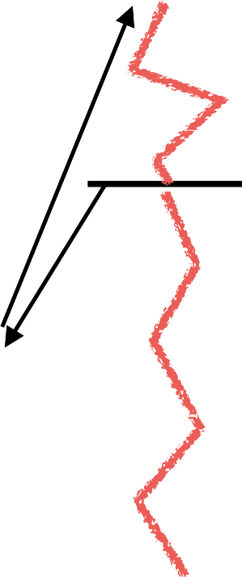

Kernel of Contiki operating system and concurrency
Contiki’s kernel is event-based
most programs run directly on top of the kernel
Thread 1
Thread 2
Multi-threading implemented as a library
Threads only used if explicitly needed (e.g., long computations)
Preemption possible
Event Handler 1
Event Handler 2
Kernel
Event Handler 3

Slide 19
Contiki operating system: Hello, World!
#include “contiki.h”
#include <stdio.h>
PROCESS(hello_world_process, “hello world”); AUTOSTART_PROCESSES(&hello_world_process); PROCESS_THREAD(hello_world_process, ev, data)
{
PROCESS_BEGIN();
// initialize statements come here
printf(“Hello world!\n\r”);
while(1) {
// perform tasks here
// PROCESS_WAIT_EVENT();
}
PROCESS_END();

Slide 20
Basics of wireless communication and networking
Link Budget: One of the metrics that help you understand the gains and losses in a communication system. Applicable to radio waves, communication happening through cables, and other systems
High link budget ensures that the wireless signal is received with a sufficient signal to noise (SNR) ratio for recovering of the sent information
Receiver Power (dBm) = Transmitted Power (dBm) + Gains (dB) – Losses (dB)

Slide 21
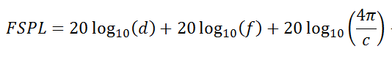
Basics of wireless communication and networking
Free space path loss (FSPL or FSL): The loss of power encountered by signal as it transmits from the transmitter to the receiver
d is the distance between the transmitter and receiver antennas (in meters),
f is the frequency of the signal (in Hertz),
c is the speed of light in a vacuum

Slide 22
Basics of wireless communication and networking
Signal to Noise (SNR) ratio: It is defined as the ratio of the desired or target signal when compared to the background noise
SNR = P(signal) / P(noise)
Often, SNR as a ratio is expressed in the units of decibel (dB)
SNR = 1, what would be the value in decibel?
We would like to have the SNR to be as high as possible. For communication systems, it means stronger desired signal, resulting in better link quality and reliability

Slide 23
Basics of wireless communication and networking
How do you estimate the capacity of the channel?
And what do you mean by the capacity of the channel?
Shannon capacity of the channel: The bandwidth available (B) , The quality of the channel (the level of noise, SNR)
C = B * log₂(1+SNR)
Intuitively, capacity increases with available bandwidth (linear) and increases with SNR (log)

Slide 24
Various tradeoffs in range, frequency, datarate, power
Power is (usually) a constraint
Increase in power can result in higher range/data rate
Lower lifespan of the device
Increase data rate (C)
Increase throughput by using a larger bandwidth (B)
Transmits at higher frequencies (f)
Range decreases and vice versa
Improve design to increase gain (G)
e.g. OFDM, MIMO etc.
C = B * log₂(1+SNR)
SNR – signal-to-noise ratio

Slide 25
Roadmap of the lecture today
Let us recall what was covered in the last lecture
Wireless communication basics
Battery lifespan estimation
Various states of radio transceivers
Energy harvesting, low-power communication (Overview)
Notes:
Here is the roadmap of the major topics that I am going to cover during the presentation. We have already covered the exponential growth of the internet of things; next, I will talk about the critical energy challenge that can severely hinder this massive growth and preventing us from realising this immense economic value enabled by the IoT.

Slide 26
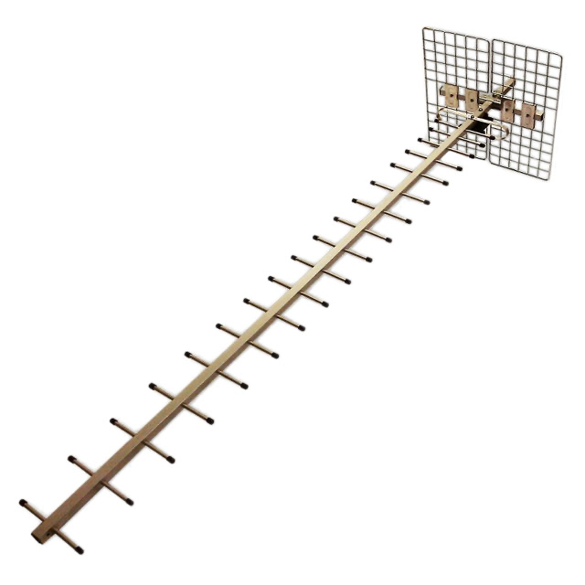
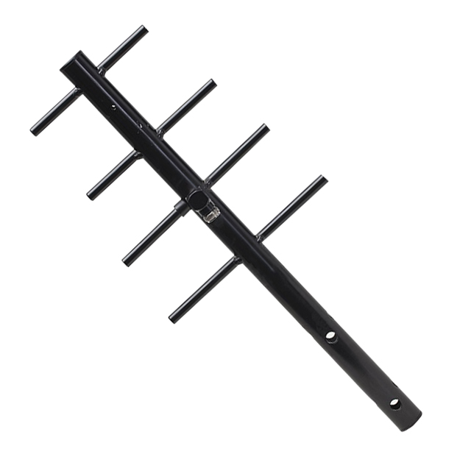
Revisiting antennas and their gain
Yagi-uda antenna. It has a very high gain. The gain and directionality increases with the number of antenna elements.
Antenna Gain: 23 dBi
Antenna Gain: 8 dBi

Slide 27
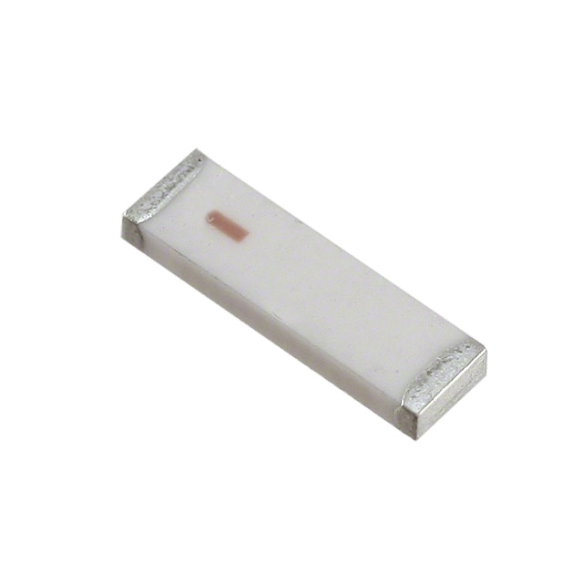
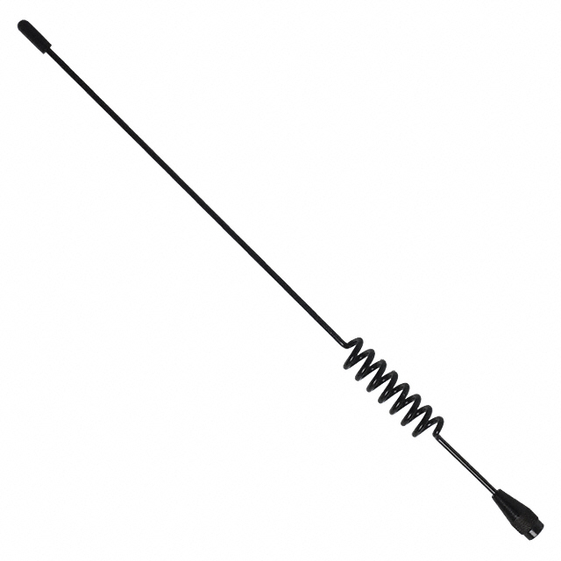
Revisiting antennas and their gain
Chip antenna makes sacrifice due to smaller form factor and hence the least gain. Whip antenna has less directionality than Yagi-uda antenna.
Antenna Gain: -1 dBi
Antenna Gain: 3.8 dBi

Slide 28
Higher frequency and directional antennas
Question: Why do higher frequencies often utilize directional antennas,? Considering devices like smartphones that operate on 5GHz WiFi, wouldn't directional antennas—despite their higher gain—be impractical since the device's orientation to the transmitter varies and cannot always align with the antenna's optimal direction?

Slide 29
Directionality of beams and interference
Question: How does the high directionality of beams at higher frequencies reduce interference, and what implications does this have for signal reception? For instance, if two individuals, Person A and Person B, are in close proximity to each other and a transmitter sends distinct, narrow radio waves to each of their devices, does the straight-line transmission ensure interference-free reception for both?

Slide 30
Frequency modulation and spectrum
Question: Why is Frequency Modulation (FM) considered more spectrum efficient compared to Amplitude Modulation (AM), despite FM's inherent characteristic of utilizing a broader frequency range due to its modulation technique?

Slide 31
Example: Shannon capacity, signal to noise ratio
Question: A communication channel using a 20MHz spectrum in the range between 2.40GHz to 2.42GHz, has a signal to noise ratio of 63.
What is the Shannon capacity of the channel?
If the transmission uses 80MHz spectrum in the range between 5.00GHz to 5.08GHz (instead of 2.40GHz to 2.42GHz), explain why the throughput can drop even though the wireless frequency band used has increased from 20MHz to 80MHz (for the same distance between transmitter and receiver). The transmit power also remains the same as when 20 MHz of spectrum was used.

Slide 32
Example: Shannon capacity, signal to noise ratio
Answer: We can use the formula C = B * log2(1+ S/N)

Slide 33
Example: Shannon capacity, signal to noise ratio
Answer: We can use the formula C = B * log2(1+ S/N)
120 Megabits/second

Slide 34
Example: Shannon capacity, signal to noise ratio
Answer: We can use the formula C = B * log2(1+ S/N)
120 Megabits/second
The signal-to-noise ratio (S/N) can decrease as the noise level increases with a wider bandwidth. Additionally, higher frequencies tend to have poorer propagation characteristics, resulting in weaker signals at the receiver. This can lead to a significant decrease in S/N, which may require increasing the transmitted power to maintain an acceptable level.

Slide 35
Roadmap of the lecture today
Let us recall what was covered in the last lecture
Wireless communication basics
Battery lifespan estimation
Various states of radio transceivers
Energy harvesting, low-power communication (Overview)
Notes:
Here is the roadmap of the major topics that I am going to cover during the presentation. We have already covered the exponential growth of the internet of things; next, I will talk about the critical energy challenge that can severely hinder this massive growth and preventing us from realising this immense economic value enabled by the IoT.

Slide 36
Power Management, Energy-Efficiency
Notes:
++ Over the past few years, I have designed several backscatter and beyond backscatter systems that precisely overcome these critical challenges that have limited the widespread deployment of backscatter on IoT devices.
++ The research vision that I have pursued and would like to pursue as a faculty member is to enable a massive deployment of IoT devices by bridging the energy asymmetry between sensing, computation and communication blocks by designing novel platforms and communication mechanisms. I am going to describe some of my research contributions next.

Slide 37
Battery-life, Power Consumption

Slide 38
Quick revision of important terms and their unit
Voltage: Volts (V): the SI unit of electromotive force
Current: Ampere or “amp” (A) is the SI unit of current
Power (W): Voltage (V) x Current (A)
Energy (Joule): Power x Time.
Example:
A device running at 1V draws 1A.
The power consumption is therefore 1W
Energy consumed in 1s is 1J

Slide 39
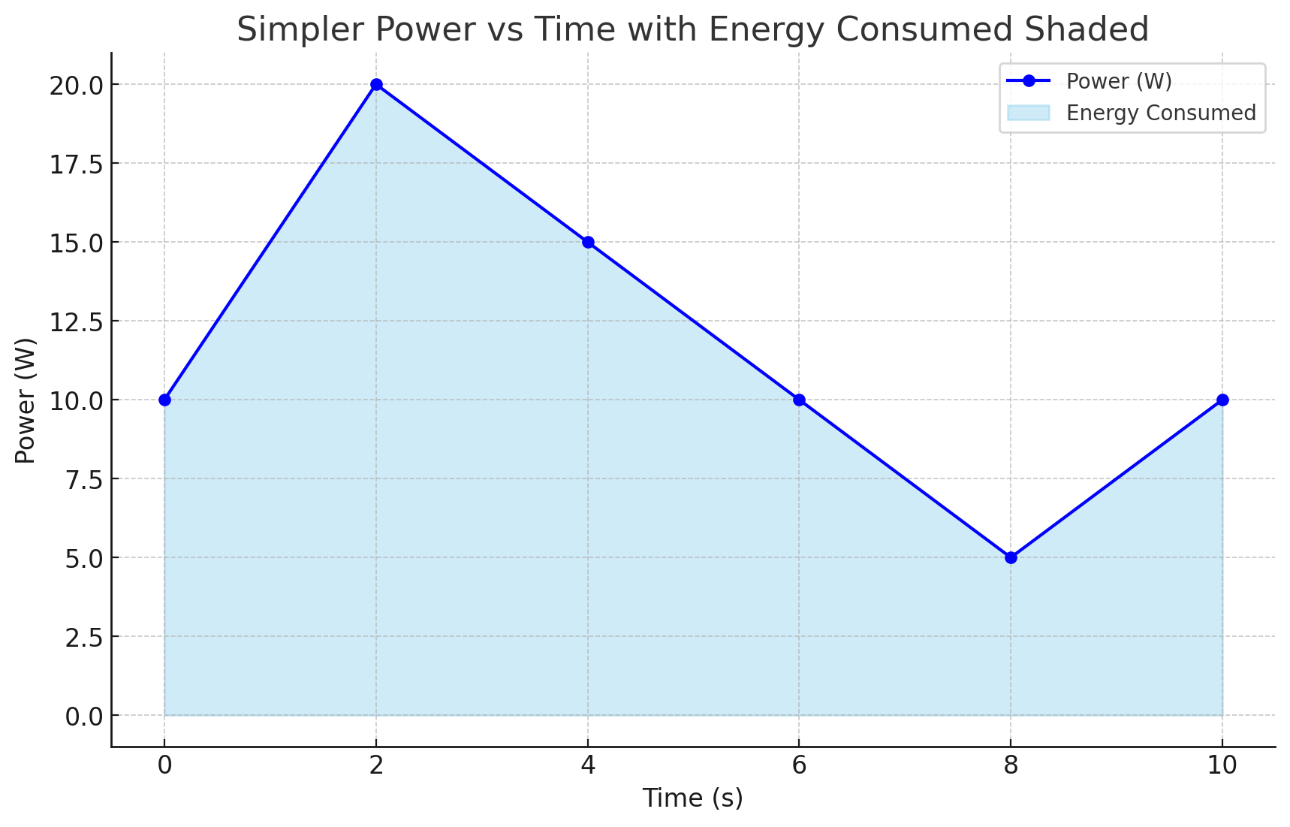
Relationship between power, energy and time

Slide 40
How do you measure the capacity of a battery?
The watt-hour (symbolized Wh) is a unit of energy equivalent to one watt (1 W) of power that is expended for one hour (1 h) of time.
Macbook Pro 16 Inch: 99.6 Watt-hour
iPad pro 12.9 Inch: 40.88 Watt-hour
An ampere-hour or amp-hour (Ah) is a unit of electric charge equal to the charge transferred by a steady current of 1A flowing for one hour:
AA Energizer Alkaline: 2500 mAh (1.5V), 3.75Wh

Slide 41
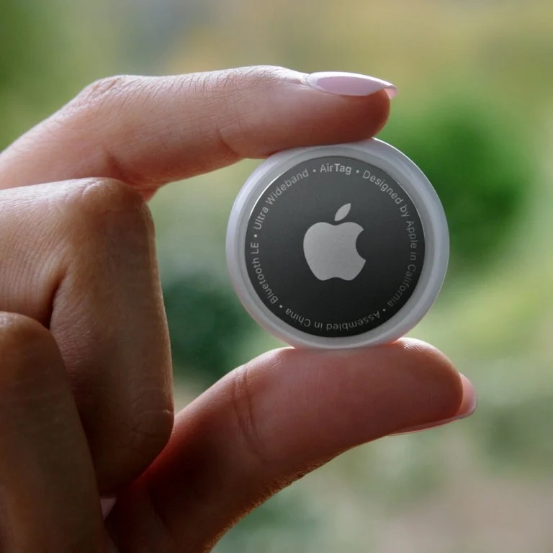
Battery Capacity: Apple AirTag

Slide 42
Battery Capacity: Apple AirTag
Coin Cell: 240 mAH

Slide 43
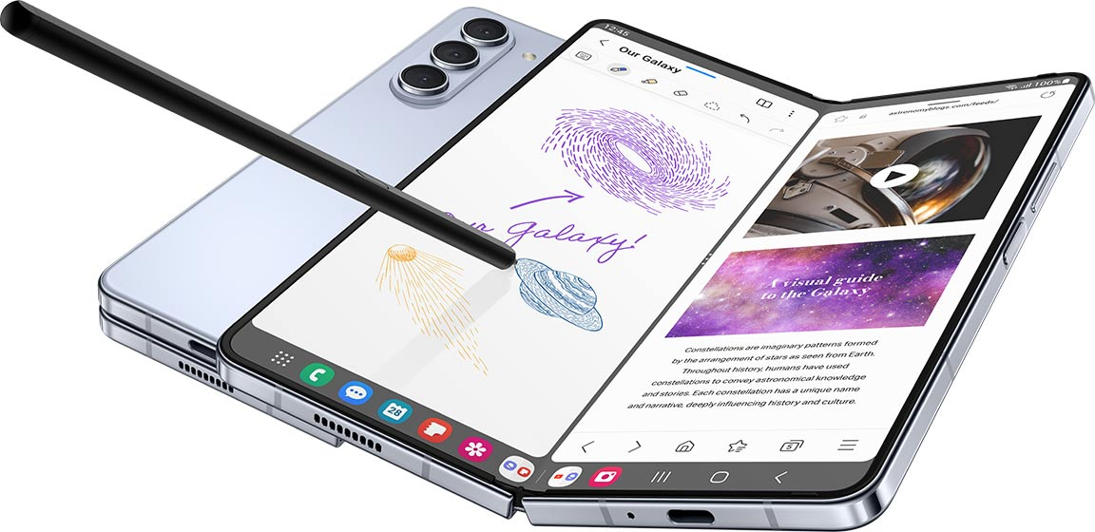
Battery Capacity: Smartphone

Slide 44
Battery Capacity: Smartphone
Lithium Ion: 3400 - 6000 mAH

Slide 45
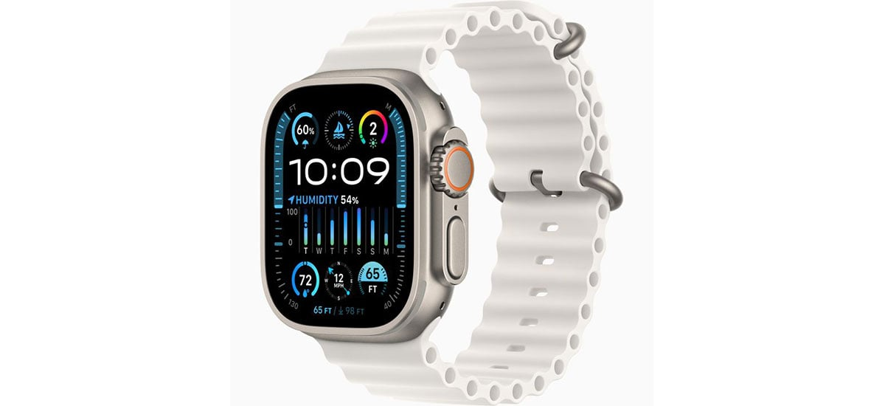
Battery Capacity: Smartwatch

Slide 46
Battery Capacity: Smartwatch
Smart watch: 400-600 mAH

Slide 47
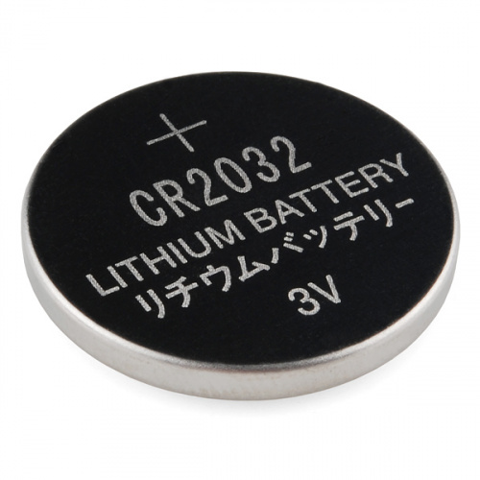
What is the capacity of the battery?
How do we calculate the lifetime of the battery in IoT devices?
We express battery capacity commonly in milliampere-hour (mAH)
Coin cell (CR2032): 240 mAh, Flexible battery (Molex): 10 mAh
How long would battery last under different device load:
Current drawn | Lifetime
240 mA | 1 h
120 mA | 2 h
1 mA | 240 h
Coin cell battery
CR 2032 (240 mAh)

Slide 48
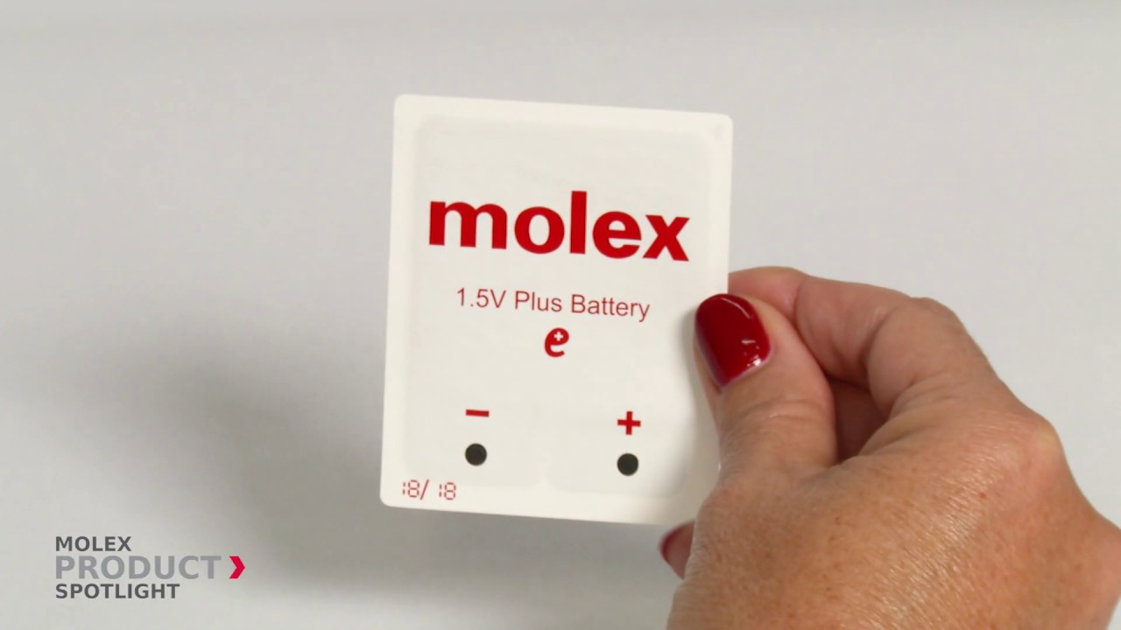
Expected lifespan of a battery in an IoT devices?
Coin cell (CR2032): 240 mAh, Flexible battery (Molex): 10 mAh
What is the battery life under different device loads:
Coin cell battery
CR 2032 (240 mAh)
Flexible Battery
(10 mAh)
Component | Current draw
Microcontroller | 200 uA
Accelerometer | 10 uA
WiFi Radio | 15 mA
Bluetooth radio | 1 mA

Slide 49
Expected lifespan of a battery in an IoT devices?
Coin cell (CR2032): 240 mAh, Flexible battery (Molex): 10 mAh
What is the battery life under different device loads:
Coin cell battery
CR 2032 (240 mAh)
Flexible Battery
(10 mAh)
Component | Current draw | Flexible Battery | Coin cell
Microcontroller | 200 uA | 50 h | 1200 h
Accelerometer | 10 uA | 1000 h | 24000
WiFi Radio | 15 mA | 45 mins | 16 h
Bluetooth radio | 1 mA | 10 h | 240 h

Slide 50
Energy Characteristics of LCD Display
Most of the power in an LCD display is consumed by the backlight, the light filter requires comparatively less power.
B Anand, K Thirugnanam, J Sebastian, PG Kannan, AL Ananda, MC Chan, RK Balan, “Adaptive display power management for mobile games,” ACM International Conference on Mobile Systems, Applications, and Services (Mobisys) 2011.

Slide 51
Energy Characteristics of OLED Display
OLED display functions without a backlight
OLED displays consume less power than a LCD display when the image is dark, but more when the image is bright
Displaying different color consumed different amount of energy

Slide 52
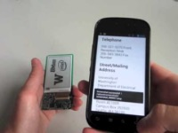
Wirelessly Powered Display

Slide 53
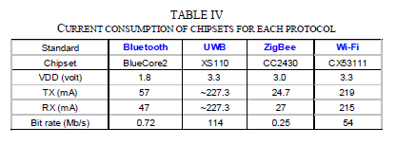
Lifespan estimation for wireless networking
A mobile device with a capacity 9.62Wh transmits continuously on:
WiFi:
Considering only network energy consumption
Power consumption: 3.3V*219mA = 722.7 mW
Duration = 9.62/0.7227 = 13.3hrs
In practice, the duration is much shorter
Bluetooth: (1.8V * 57mA = 102.6mW)
Duration = 9.62/(1.8*0.057) = 93.76hrs

Slide 54
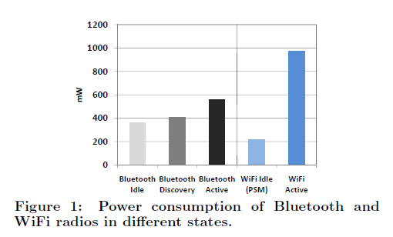
Different transmission states for wireless networking
Devices rarely transmit continuously.
Having different power states allow power consumption to be reduced

Slide 55
Spikes in the power consumption of smartphones are due to wireless networking events
WiFi state transition for beacon communication is (relatively) fast
However, state transition for data communication is (still) slow due to driver/software overhead

Slide 56
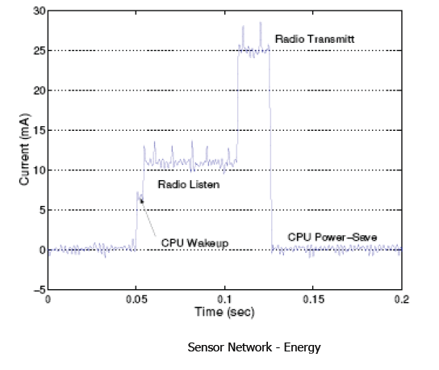
Current consumption for a wireless embedded device for various states of the radio transceiver

Slide 57
Current consumption for a wireless embedded device for various states of the radio transceiever
What are the desirable properties for radio to operate in low power?

Slide 58
Roadmap of the lecture today
Let us recall what was covered in the last lecture
Wireless communication basics
Battery lifespan estimation
Various states of radio transceivers
Energy harvesting, low-power communication (Overview)
Notes:
Here is the roadmap of the major topics that I am going to cover during the presentation. We have already covered the exponential growth of the internet of things; next, I will talk about the critical energy challenge that can severely hinder this massive growth and preventing us from realising this immense economic value enabled by the IoT.

Slide 59
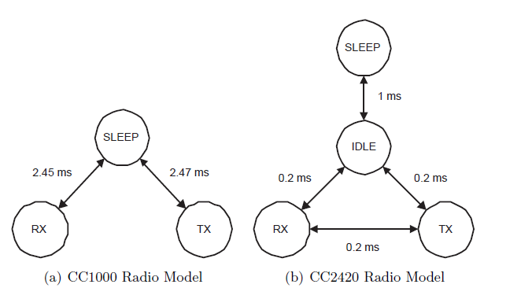
Different states of a radio transceiver
Energy conserved by placing the radio transceivers into low power states when they are not active

Slide 60
Cellular Network: 3G/4G Radio State
State transition in cellular network incurs high overhead
Radio stays in high power states in anticipation of data transfer

Slide 61
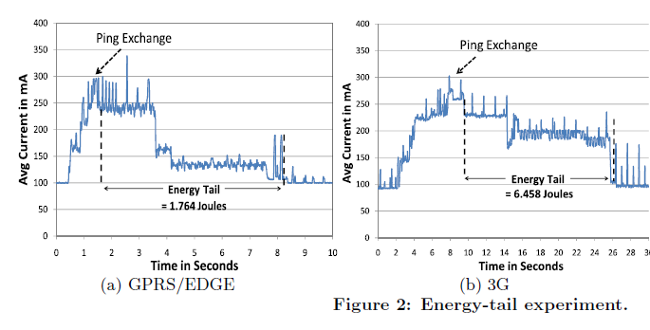
Cellular “Tail” Behavior in power consumption trace
This “tail” behavior causes cellular radio to be very inefficient for infrequent transfer of small amount of data

Slide 62
Let us talk about Bluetooth standard
Data Rate: 125Kbps – 2 Mbps
Classes
Class 1,1.5: 10-100mW
Class 2: 2.5mW
Class 3: 1mW
ISM band 2.4GHz (2.402GHz – 2.480GHz)
Point-to-point, broadcast, mesh

Slide 63
Let us talk about Bluetooth standard: Bluetooth Low Energy (CC2640)
Tx Current: ~ 6.1mA (0dBm)
Tx Current: ~ 15mA
Latency: 3 ms
Sleep current ~ 1µA
Designed for sending small chunks of data

Slide 64
SensorTag: Current consumption for radio states
For comparison,
RaspberryPi 3 (ARM Cortex-A53): 1W - 2W
I7-7600U@2.8GHz (laptop): 7.5W (down), 15W (typical), 25W (up)
I7-7700@3.6GHz (desktop): 65W (typical)

Slide 65
Duty Cycling Networking Interfaces

Slide 66
Examples of Duty Cycling (Network Interface)
Compare WiFi (100Mbps) and ZigBee/802.15.4 (250kbps), 1s cycle, assume same voltage
WiFi, three states;
Transmit: 280 mA
Receive: 180 mA
Idle: 10 mA
802.15.4, three states:
Transmit: 30 mA
Receive: 18 mA
Idle: 0.426mA

Slide 67
Examples of Duty Cycling (Network Interface)
100% utilization (50% transmit, 50% receive)
WiFi: (180+280)/2 = 230mA
802.15.4: (18.8+30)/2 = 24.4mA (10.6% of WiFi)
10% utilization (5% transmit, 5% receive, 90% idle)
WiFi: 230*0.1 + 10*0.9 = 32mA
802.15.4: 24.4*0.1 + 0.426*0.9 = 2.823mA (8.8% of WiFi)
1% utilization (0.5% transmit, 0.5% receive, 99% idle)
WiFi: 230*0.01 + 10*0.99 = 12.2mA
802.15.4: 24.4*0.01 + 0.426*0.99 = 0.6657mA (5.46% of WiFi)

Slide 68
Energy consumption calculation for an embedded device

Slide 69
Lifespan calculation for a embedded device
Illustrative readings for different state of radio transceiver:
Idle power consumption(MCU) : 10mA
Transmitting (PTX) : 20mA
Receiving (PRX) : 10mA
Sleeping : 0.1mA
Battery = 2 (1.5V) AA batteries, each provides 2300 mAh
Total battery power = 2 * 1.5 * 2.3 = 6.9Wh

Slide 70
Lifespan calculation for a embedded device
The clock frequency of the microcontroller: 48 MHz
What is one clock cycle?

Slide 71
Lifespan calculation for a embedded device
The clock frequency of the microcontroller: 48 MHz
What is one clock cycle? 20.8 nanoseconds

Slide 72
Lifespan calculation for a embedded device
The clock frequency of the microcontroller: 48 MHz
What is one clock cycle? 20.8 nanoseconds
Please assume the following:
Average instructions takes 8 clock cycles
The task takes on an average 20,000 cycles
How much time is taken for execution of the tasks?

Slide 73
Lifespan calculation for a embedded device
The clock frequency of the microcontroller: 48 MHz
What is one clock cycle? 20.8 nanoseconds
Please assume the following:
Average instructions takes 8 clock cycles
The task takes on an average 20,000 cycles
How much time is taken for execution of the tasks?
8 * 20000 * 20.8 (nano seconds) = 3.32 milliseconds

Slide 74
Lifespan calculation for a embedded device
Data rate for wireless transmissions: 250 kilobits/second
Amount of data to be transmitted: 50 bytes
Time taken = (50 * 8)/250000 = 1.6ms
Current drawn (transmit + CPU) = 30mA
Current drawn
= 30 * 1.6
= 0.048mAs

Slide 75
Lifespan calculation for a embedded device
Duration of active period (compute + transmit) = 3.32 + 1.6 milliseconds
Let sensor node operates continuously:
Lifetime =

Slide 76
Lifespan calculation for a embedded device
Let sensor node operates once a second
Lifetime =

Slide 77
Roadmap of the lecture today
Let us recall what was covered in the last lecture
Wireless communication basics
Battery lifespan estimation
Various states of radio transceivers
Energy harvesting, low-power communication (Overview)
Notes:
Here is the roadmap of the major topics that I am going to cover during the presentation. We have already covered the exponential growth of the internet of things; next, I will talk about the critical energy challenge that can severely hinder this massive growth and preventing us from realising this immense economic value enabled by the IoT.

Slide 78
Low-Power Wireless Transmissions through Backscatter Communication

Slide 79
Basics of backscatter communication
Vary between absorbing or reflecting signal to modulate data
Wireless transmissions at microwatts of power draw (10000x energy savings)
Frequency bands: 400 MHz, 900 MHz, 2.4 GHz
Ambient RF signal
Antenna
Reflected (backscatter) signal
RF Switch
Modulating Signal (Digital)
Backscatter tag
Reader/ Receiver

Slide 80
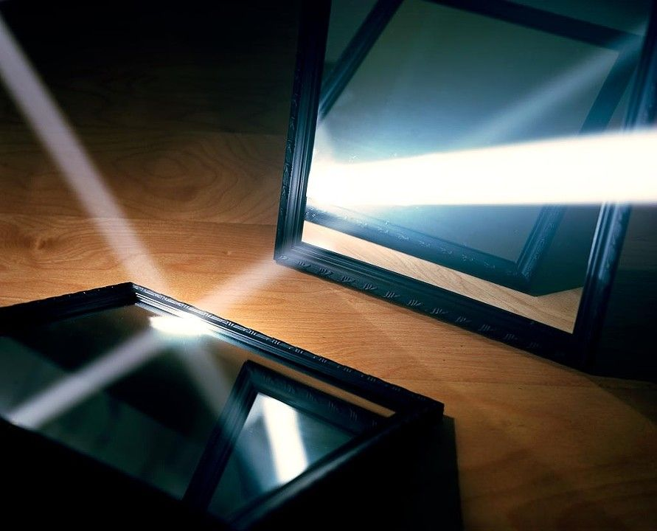
One way to understand backscatter transmissions
Notes:
++ While we are deploying an enormously large number of IoT devices, I claim that very little attention is being paid to their energy challenge.
++ Today, most IoT devices are very energy expensive, and consequently, they rely on bulky batteries such as AA/AAA sized batteries for their operation. Even when operating on these batteries, they require frequent replacement of the exhausted batteries. This can be challenging when performed at a massive scale, especially considering that we may have a trillion embedded device deployed in the world.
++ Further, it can also harm the environment. These batteries use toxic chemicals, which means now we can have billions of toxic chemicals laden batteries that would be disposed of in landfills. This is especially important as sustainability has become an essential aspect across the world; in fact, imperial college was celebrating sustainability week.

Slide 81
Backscatter transmits at (up to) 10000x lower power consumption than conventional radios
Backscatter through absorption or reflection of ambient wireless signals enables wireless transmissions at microwatts of power consumption
Ambient RF signal
Antenna
Reflected (backscatter) signal
RF Switch
Modulating Signal (Digital)
Backscatter tag
Receiver
Notes:
Backscatter communication actually help us overcome this limitation

Slide 82
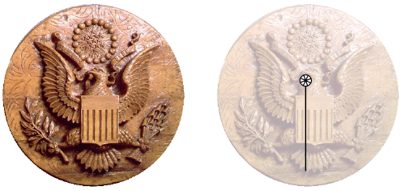
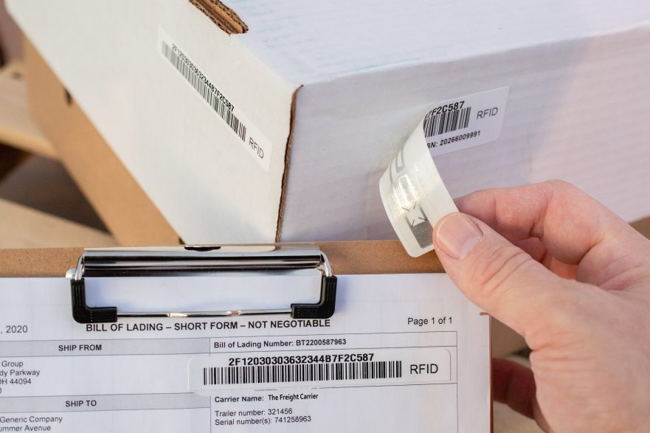
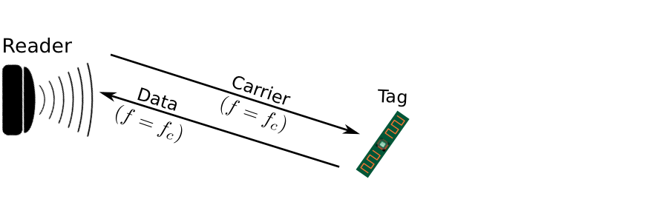
Backscatter is not a new transmission mechanism
First backscatter system: Great seal bug (The Thing) 1945
RFIDs: one of the most widely deployed backscatter system
Great Seal Bug (Backscatter device embedded for spying)
RFID System

Slide 83
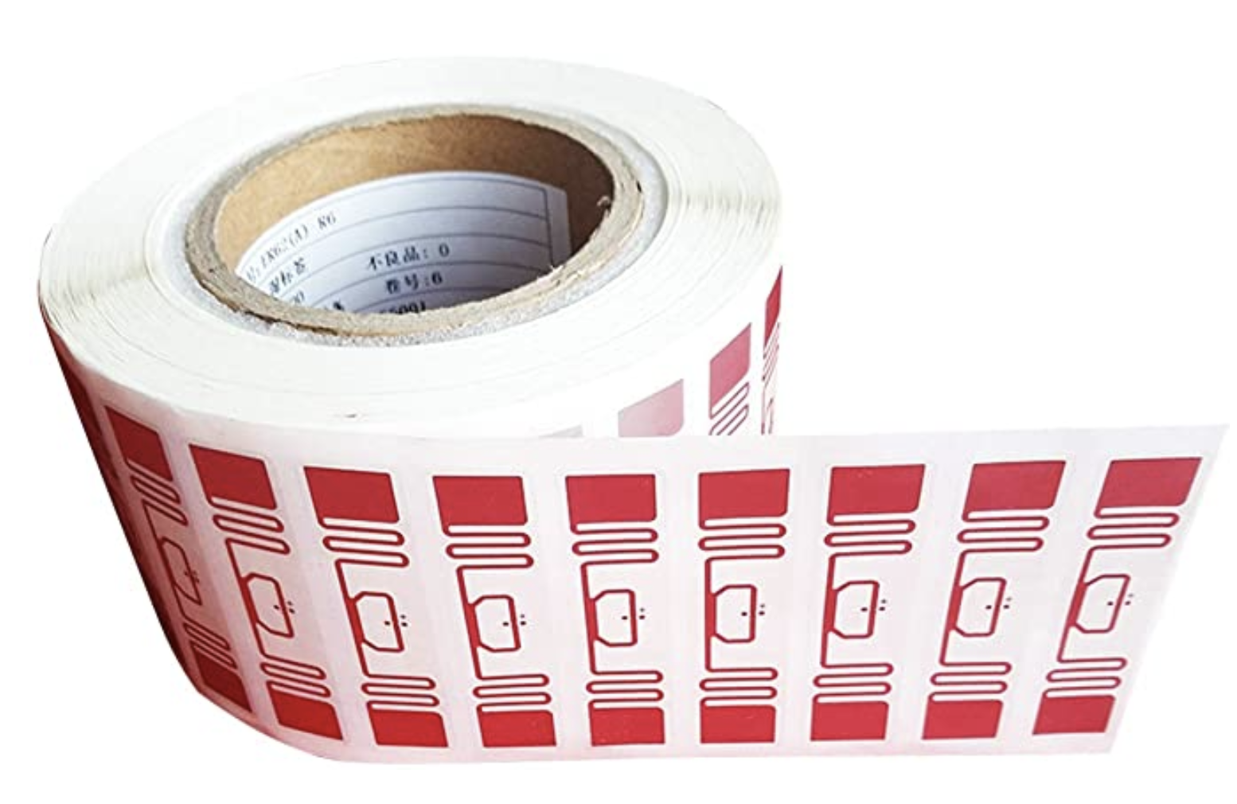
RFID is everywhere nowadays
Fundamental design principle is asymmetry
Extremely simple, cheap tags
Complex readers

Slide 84
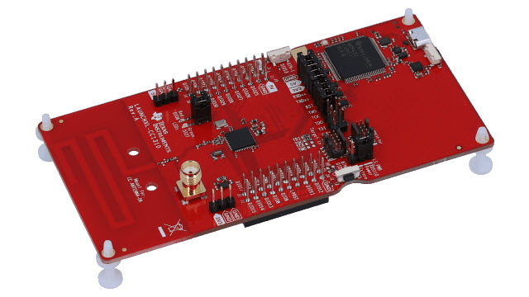
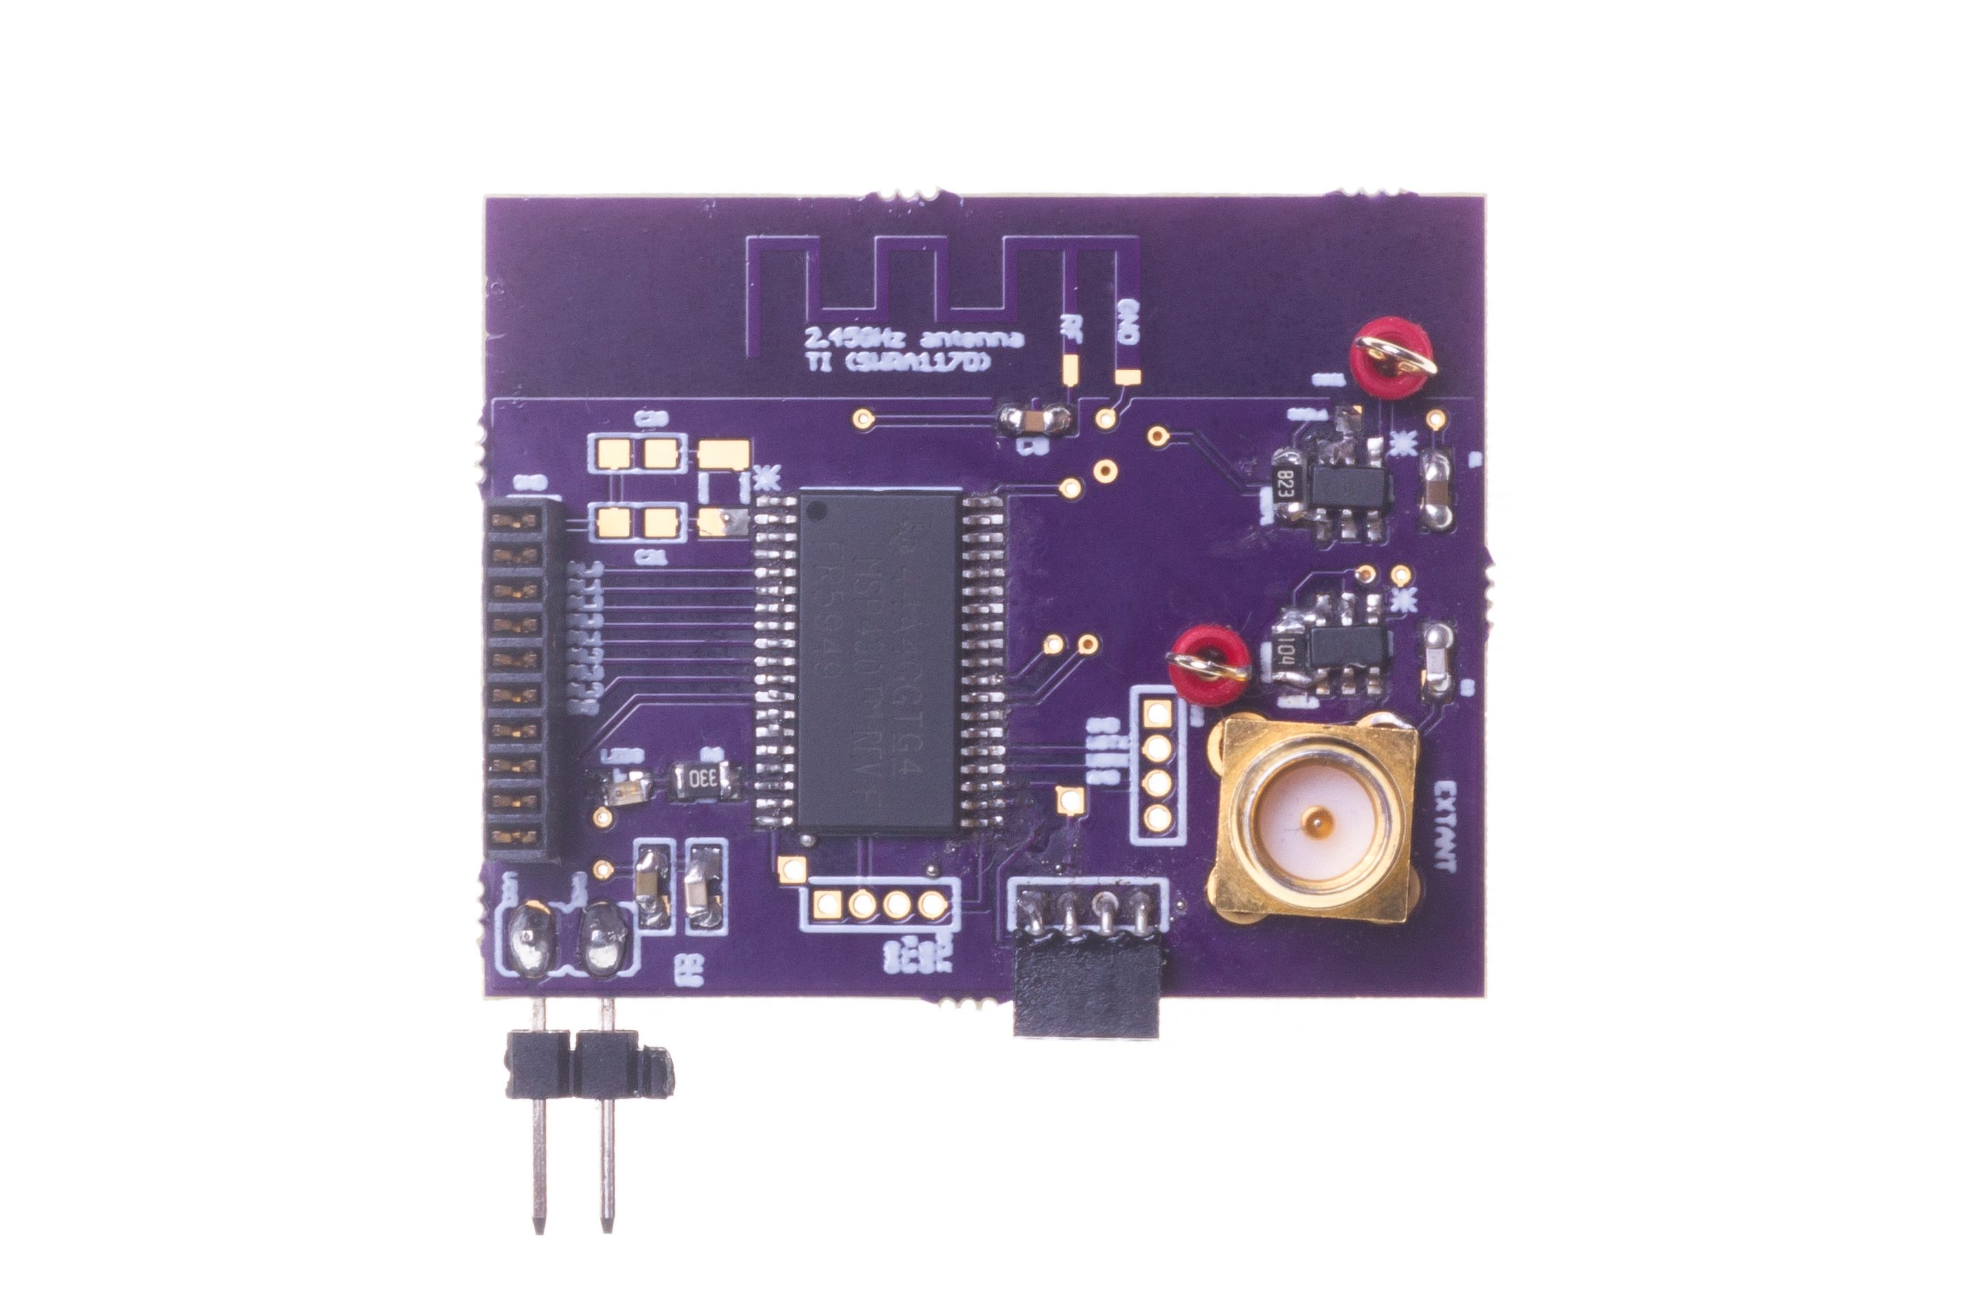
LoRea bridges the energy asymmetry between communication (TX), sensing and processing
Component | Power Consumption
LoRea (Transmissions) | 70 µW (868 MHz)
Conventional Transceiver | Tens to hundreds of mW’s
Microcontroller (Apollo3) | 100s of µW’s
Sensors | Few to tens of µW’s
Off-the-shelf hardware for transmission and receptions. Tens of USD
Overturn notion that backscatter is a short-range transmission mechanism
LoRea transmits at similar power consumption as a sensor
Texas Instruments CC1310 Launchpad: Receiver
Backscatter Tag Hardware Prototype
(Peak Power of 70 µW)
Notes:
+ Thus, with LoRea, we were able to design a backscatter system that was able to overcome the range and cost limitations that had limited all the existing backscatter system, and had hindered the widespread usage of the mechanism on the IoT devices
.
+ In fact, the backscatter tag even though it was designed using off-the-shelf components is orders of magnitude more efficient than commercial transceivers while supporting orders of magnitude lower power consumption.
+ the entire backscatter setup costs just few tens of USDs, which dramatically lowers the cost of infrastructure required to support the backscatter tags and carrier emitter device.

Slide 85
Let’s look at the battery-life again
Notes:
++ Over the past few years, I have designed several backscatter and beyond backscatter systems that precisely overcome these critical challenges that have limited the widespread deployment of backscatter on IoT devices.
++ The research vision that I have pursued and would like to pursue as a faculty member is to enable a massive deployment of IoT devices by bridging the energy asymmetry between sensing, computation and communication blocks by designing novel platforms and communication mechanisms. I am going to describe some of my research contributions next.

Slide 86
What is the expected lifespan of a battery?
Coin cell (CR2032): 240 mAh, Flexible battery (Molex): 10 mAh
Backscatter transmitter: (LoRea, SENSYS 2017) – 35 uA
Let’s estimate long would battery last under different device load:
Component | Current draw | Flexible Battery | Coin cell
Microcontroller | 200 uA | 50 h | 1200 h
Accelerometer | 10 uA | 1000 h | 24000
WiFi Transmitter | 15 mA | 45 mins | 16 h
Bluetooth Transmitter | 1 mA | 10 h | 240 h
Backscatter Transmitter | 35 uA | 285.7 h | 6857 h

Slide 87
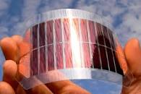
What's next? Embedded systems on harvested energy
𝜇W
Energy harvester
Microwatts of power available to harvest from ambient sources
Notes:
++ The high-power consumption for the IoT platforms also blocks an important and promising direction to enable the sustainable deployment of large-scale embedded devices. This is to eliminate batteries from these platforms altogether. If we eliminate batteries, how do we power these devices?
++We use the fact that ambient energy sources surround us. We are constantly bombarded with radio frequency transmissions such as television, wifi, radio signals, or we have waste heat energy sources, or the indoor light is ubiquitous. All these sources could be harvested to derive energy to power the IoT devices and platforms and eliminate the overhead associated with batteries on these platforms. However, the challenge that we encounter is that we could only derive microwatts of power from these ambient sources, which is sufficient to power the sensors and microcontrollers. However, we need orders of magnitude higher power for operating radio transceivers such as LoRa. This makes it challenging, if not impossible, to power sensors through energy derived from the environment.

Slide 88
Embedded systems on harvested energy
Batteries/Capacitors can potentially be recharged by environmental effects
Some examples
Solar : solar cell
Wind: micro wind turbine can be used to harvest wind energy readily available in the environment in the form of kinetic
Thermal: capture energy from industrial equipment, structures, and even the human body.
Vibration: vibration from engines can stimulate piezoelectric materials, as can the heel of a shoe.
Kinetic: translate movement to change in electromagnetic flux
Radio Frequency (RF): convert ambient RF signal into energy (demo video)

Slide 89
Roadmap of the lecture today
Let us recall what was covered in the last lecture
Wireless communication basics
Battery lifespan estimation
Various states of radio transceivers
Energy harvesting, low-power communication (Overview)
Notes:
Here is the roadmap of the major topics that I am going to cover during the presentation. We have already covered the exponential growth of the internet of things; next, I will talk about the critical energy challenge that can severely hinder this massive growth and preventing us from realising this immense economic value enabled by the IoT.

Slide 90
Wireless Networking
Ambuj Varshney
ambujv@nus.edu.sg
Notes:
++ Thank you for inviting me to give this talk
++ In this talk, I will present a pathway that can enable us to make wireless embedded systems ubiquitous. I will describe my previous research efforts that tackle the critical challenges that limit the growth of wireless embedded systems. These are related to the growing energy asymmetry that exists between sensing, computation and communication blocks on these platforms.
++ Finally, I will conclude my talk by covering the research agenda that I would like to work on as a faculty member.

